Slide 1
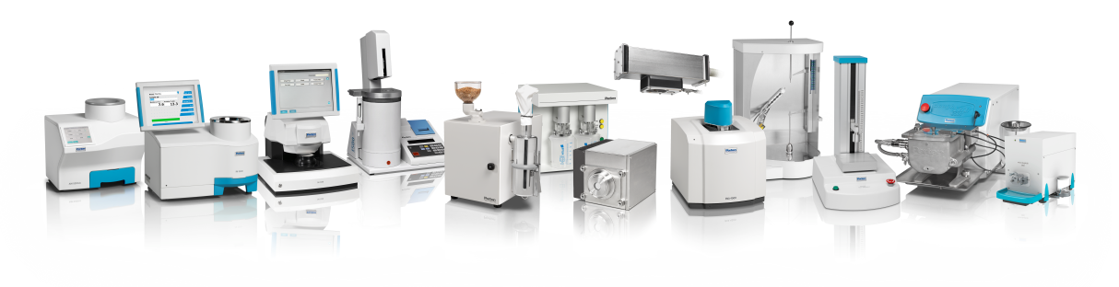
Your partner in Agri Food Quality Control
Company Overview

Slide 2
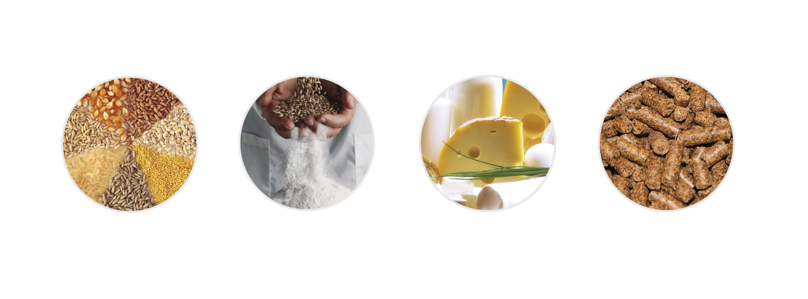
Analytical solutions for Agri Food Industries
Grain
Flour
Food
Feed

Slide 3
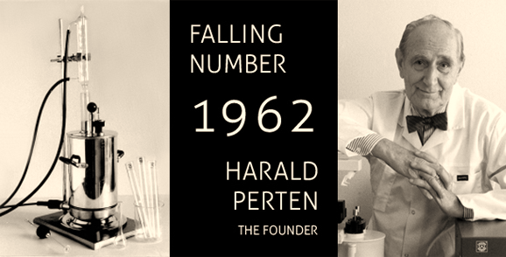



Our History
Harald Perten, a cereal chemist, founded the company in 1962.
Notes:
After arriving with his family in Sweden during the 2nd World War Harald Perten started to work with Dr Hagberg researching wheat quality control methods. Their work resulted in the Falling Number method, which Harald Perten turned into a product – the Falling Number instrument, and the company Perten Instruments was founded to commericialize the product. The company is still family owned, now by Harald Perten’s two sons, still with the same passion for quality control.

Slide 4
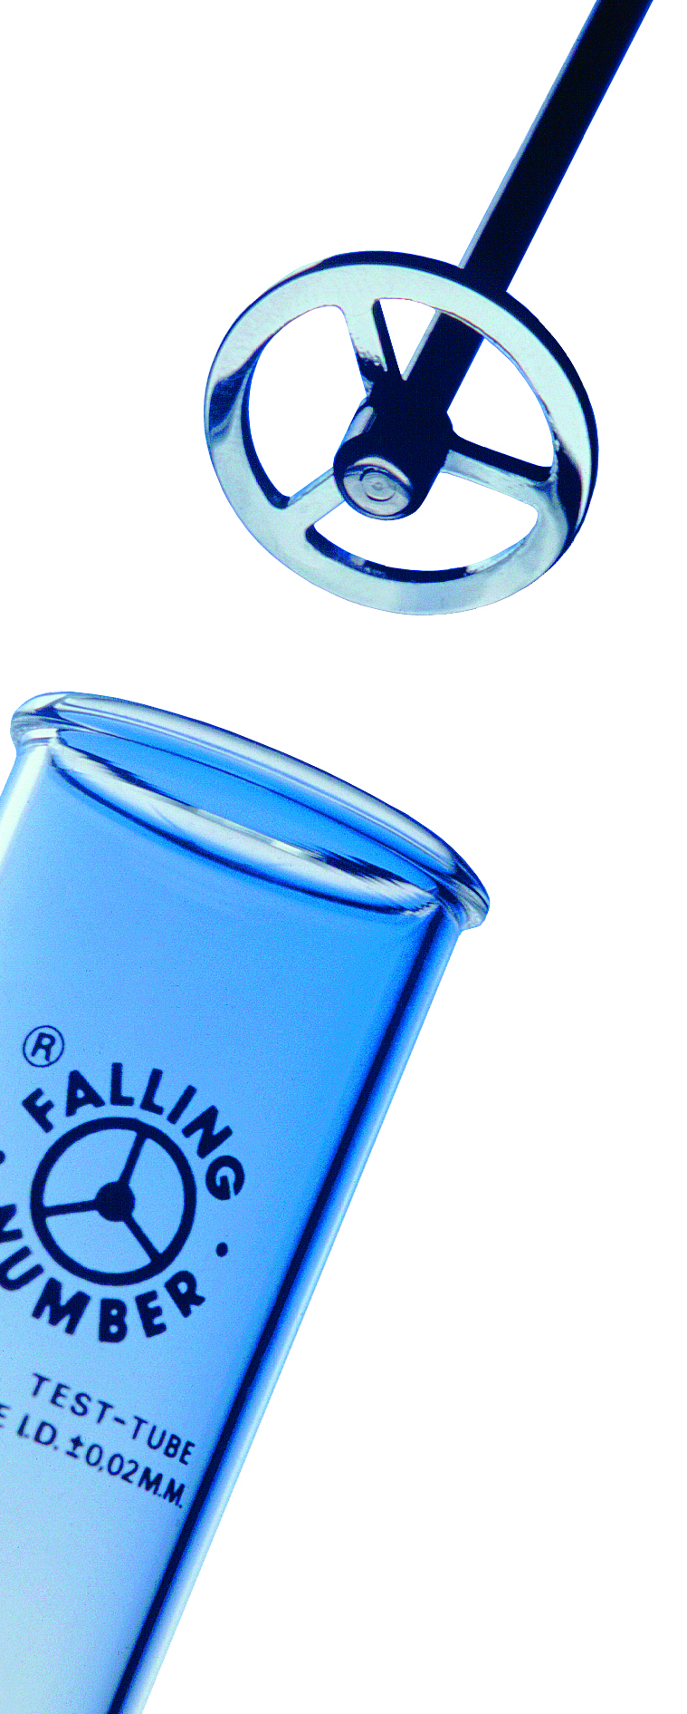

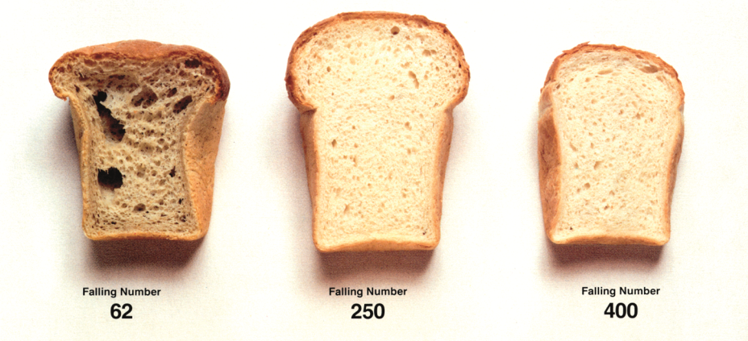
Innovation & Quality
50 years ago Perten developed the Falling Number method and instrumentation.
Falling Number, and later Gluten Index, were accepted as the world standards.

Slide 5
Business Foundation
Vision
To be the leading and most respected provider of solutions for quality measurement of the Agri/Food industries.
Mission
Perten supplies solutions that facilitate industry to produce high quality Agri/Food products efficiently.

Slide 6
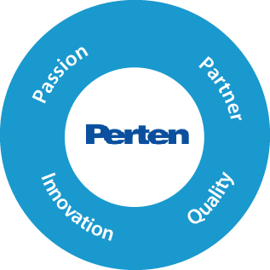

Business Foundation Core Values
Value Words
Brand Values
Serve/Act
Can do attitude, Arrange, Deliver
Empower
Allow, Charge, Entrust
Accountability
Responsible
Win
Accomplishment, Winning Team

Slide 7
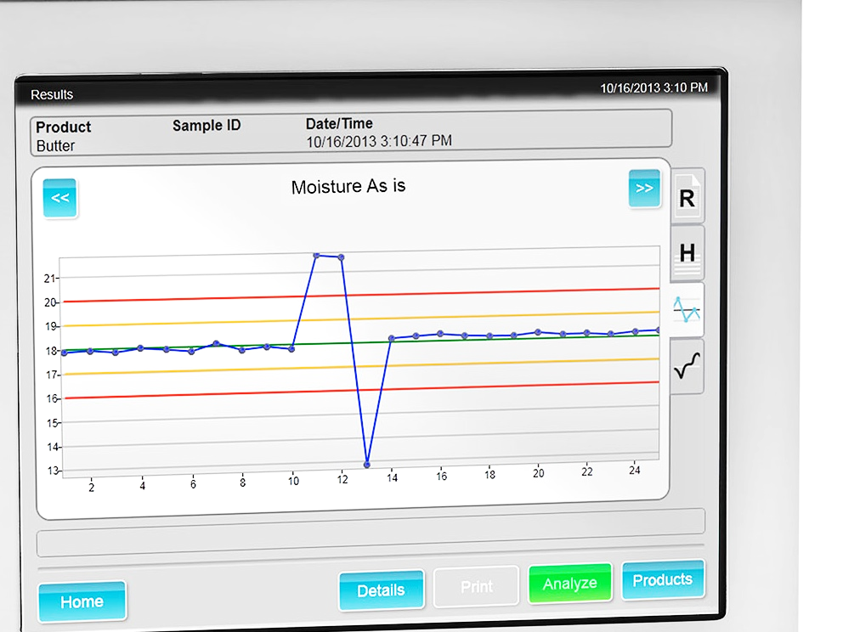
Accurate
Easy to Use

Slide 8







Overview of customer benefits by market segment
Customer Problem
Application
Perten Solution
Grain Trade
Pay the right price
Moisture, Protein, Oil
Falling Number (FN)
AM, IM 9500 & 8800, FN, DA
Share of sales
Growth
Customers
Avoid bad shipments
Moisture, Protein, Falling Number
AM, IM 9500 & 8800, FN
~60%
Grain traders
Breeders
Processing companies
Grain Processing and
Feed Production
Test raw material suitability
Moisture, FN, Gluten, Protein, Water abs.
IM 9500, DA 7250, FN, GM, dL
Optimize process
Moisture, Protein, Ash
DA 7250, DA 7300, IM 9500
Share of sales
Growth
Customers
~30%
Oil seed crushers
Flour mills
Feed producers
Verify end products
Moisture, Protein, Ash
DA 7250, DA 7300
Processed Foods
Correct & improved
consumer experience
Texture, Viscosity, Size
TVT, RVA, BVM
Share of sales
Growth
Customers
Improve margins, correct specification
Moisture, Fat, Protein
DA 7250, DA 7300, DA 7440
~10%
Snack food producers
Meat producers
Dairy producers

Slide 9
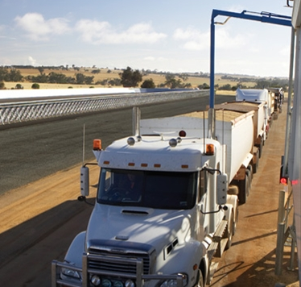
Our customers Grain Processing
Grain
Coops, traders
Breeders
Oilseed crushing
Ethanol production
Other grain processing
Key drivers
Payment analysis
Moisture monitoring
Sorting grain according to quality
Process optimization
Fast analysis for breeders
Notes:
The company was founded to serve the wheat milling and baking industries, and from there we have grown to serve the full Agri Food industry – from farm to fork. We work with companies in a wide range of businesses within the industry.

Slide 10
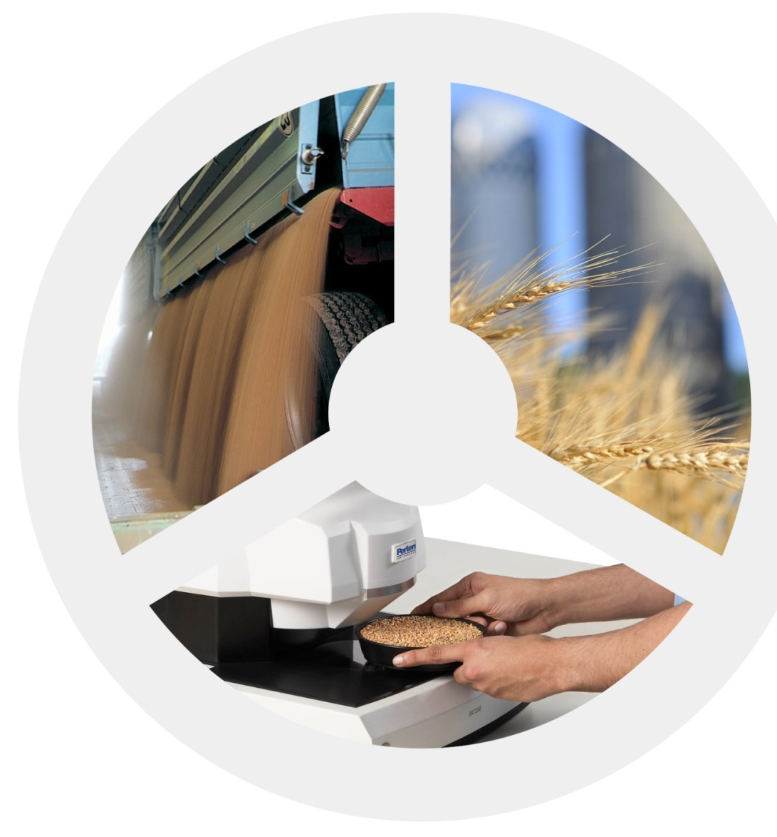
Our customers Grain Processing
Grain
Coops, traders
Breeders
Oilseed crushing
Ethanol production
Other grain processing
Key drivers
Payment analysis
Moisture monitoring
Sorting grain according to quality
Process optimization
Fast analysis for breeders

Slide 11
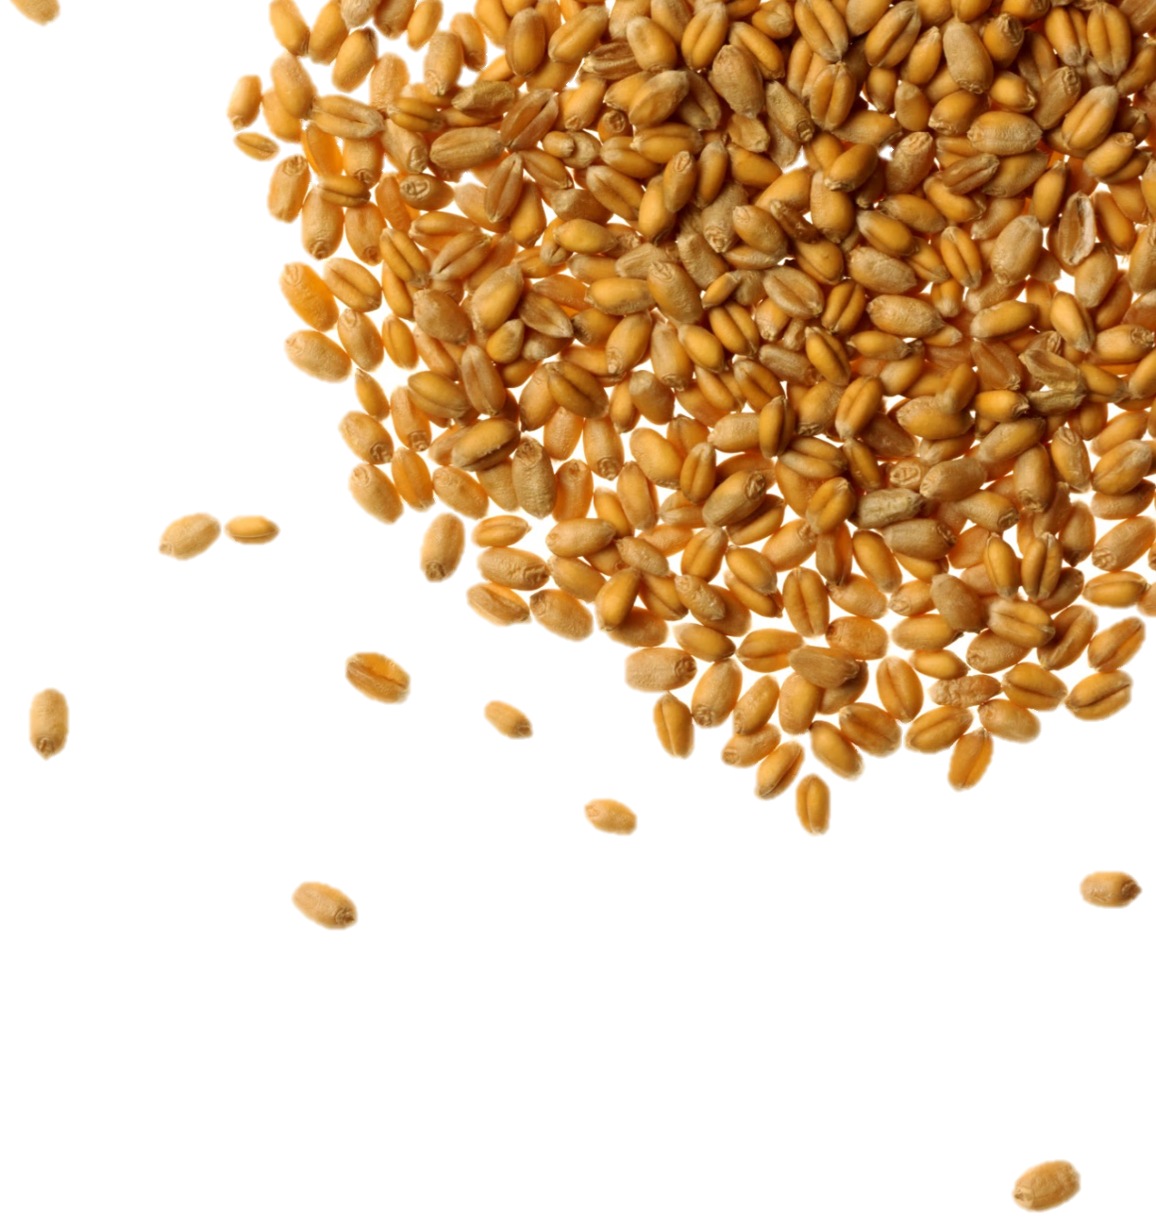
Our customers Grain Processing
Grain
Coops, traders
Breeders
Oilseed crushing
Ethanol production
Other grain processing
Key drivers
Payment analysis
Moisture monitoring
Sorting grain according to quality
Process optimization
Fast analysis for breeders

Slide 12
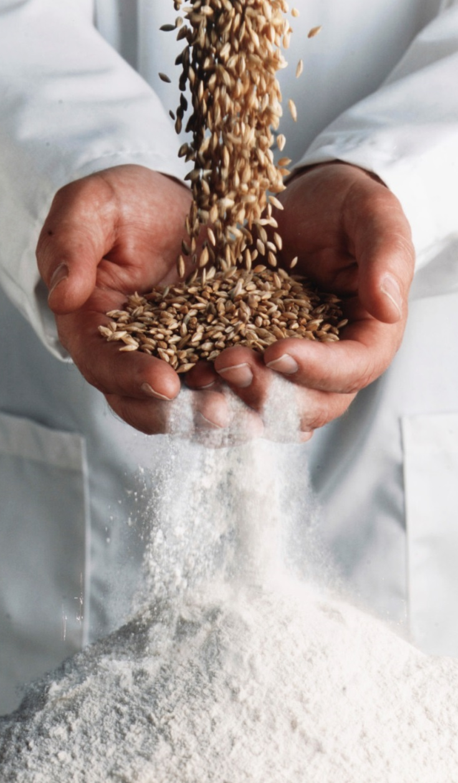
Our customers Flour Milling
Flour
Flour mills
Bake mixes
Baking
Pasta & Noodles
Key drivers
Quality control of incoming and outgoing material
Optimizing milling
Mixing to meet customer specifications
Product development
On line process control
1. Purchase the right wheat
2. Optimize milling
3. Verify flour quality
Notes:
The company was founded to serve the wheat milling and baking industries, and from there we have grown to serve the full Agri Food industry – from farm to fork. We work with companies in a wide range of businesses within the industry.

Slide 13
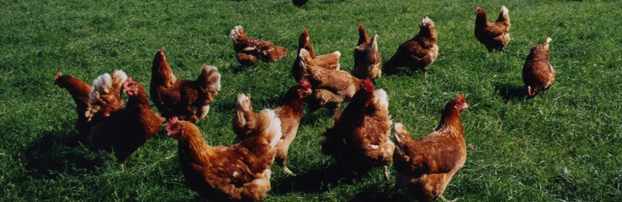
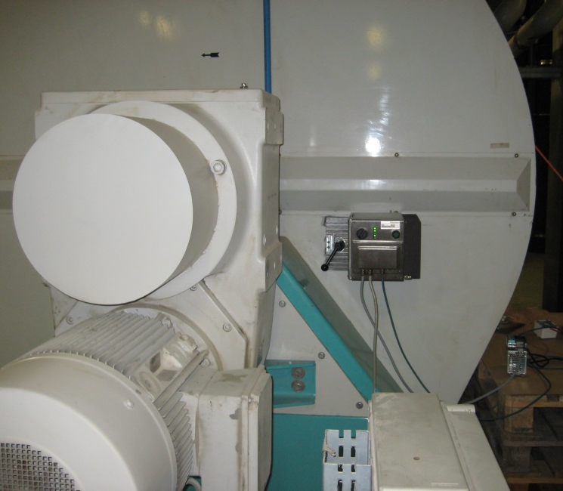
Our customers Feed industry
Feed
Feed mills
Petfood
Additives
Rendering
Key drivers
Payment analysis
Final product Quality control
Optimizing recipe according to nutrition and costs
On line control to increase throughput and save energy
Notes:
The company was founded to serve the wheat milling and baking industries, and from there we have grown to serve the full Agri Food industry – from farm to fork. We work with companies in a wide range of businesses within the industry.

Slide 14

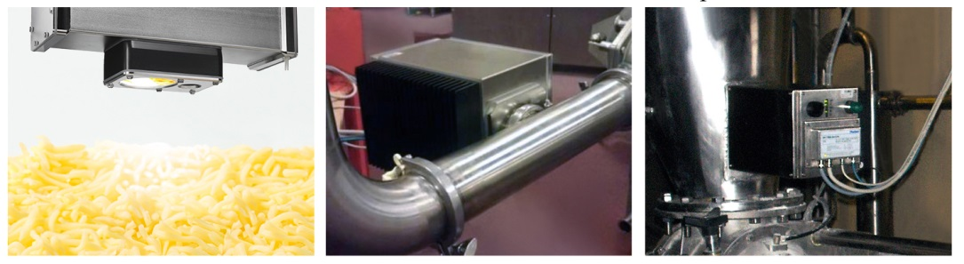
Our customers Food producers
Food
Snack foods
Dairy
Starch
Various food products
Key drivers
Ingredient analysis
Product development
Process optimization
Final product Quality control
On line process optimization
Notes:
The company was founded to serve the wheat milling and baking industries, and from there we have grown to serve the full Agri Food industry – from farm to fork. We work with companies in a wide range of businesses within the industry.

Slide 15
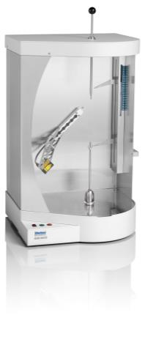
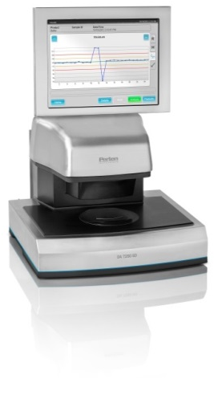

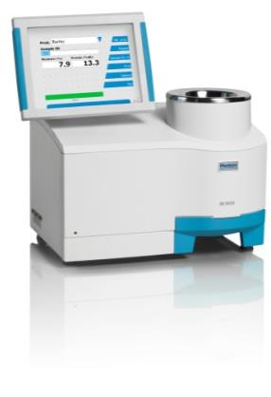
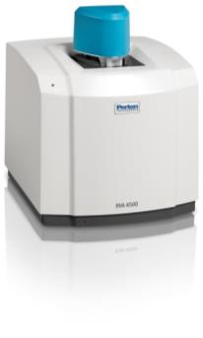
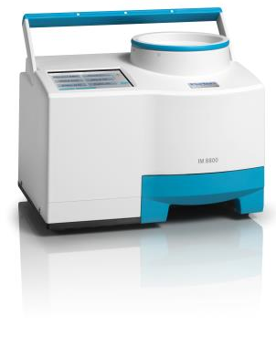
Instruments for different type of analysis
Compositional analysis
% analysis of constituents
Replace old tedious methods
Possible to use in lab and for on line process control
Strong growth
Functional analysis Rheology
Properties rather than constituents
Used as de facto or official standard
Used in Food product development & research
IM 8800
DA 7250SD
IM 9500
FN 1700
RVA 4500
BVM

Slide 16
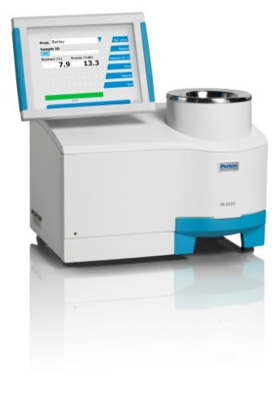
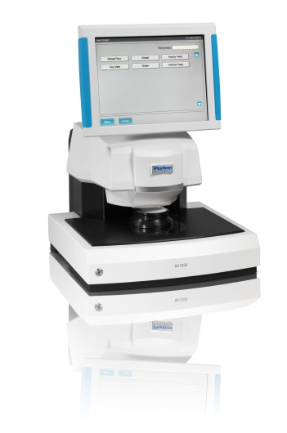
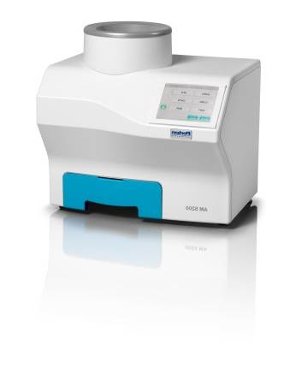
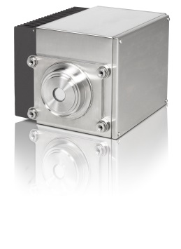
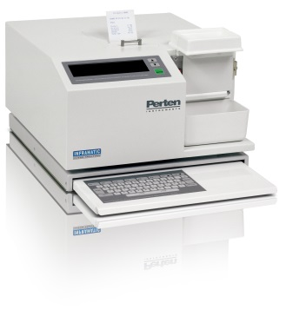
Compositional analysis

Slide 17
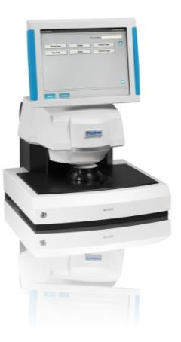
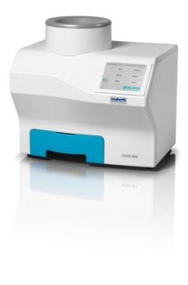
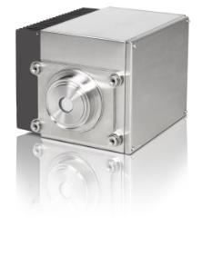

Compositional analysis

Slide 18
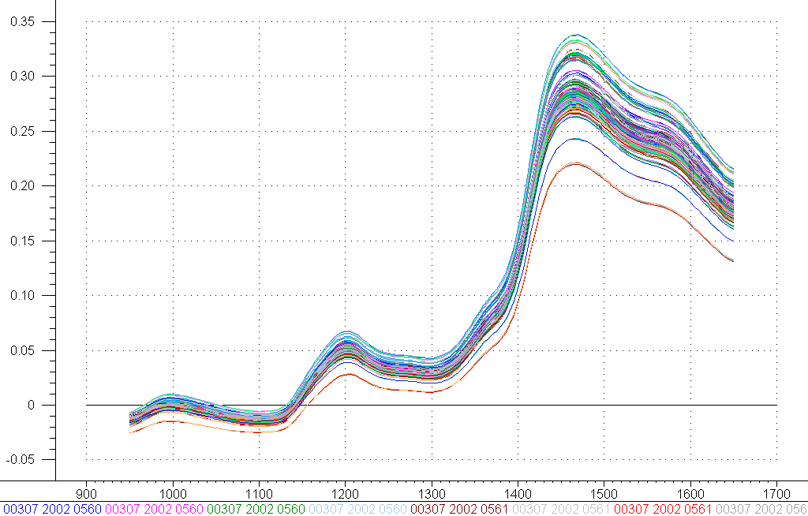
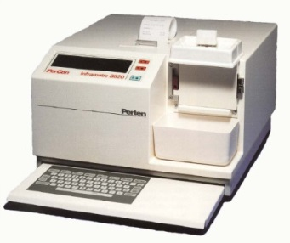
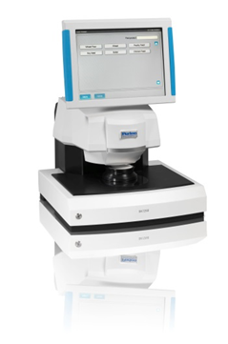
A long history in NIR
In 1980 Perten Instruments developed its first NIR instrument.
Notes:
Perten Instruments is probably the company with the longest experience from NIR in the agrifood industry. Since 1980 we have installed more than 10,000 NIR instruments in the industry, all over the world. We have continuously developed our products, and have always been on the forefront of technology. Our latest development include diode array based instruments – the most modern and advanced NIR technology available.

Slide 19
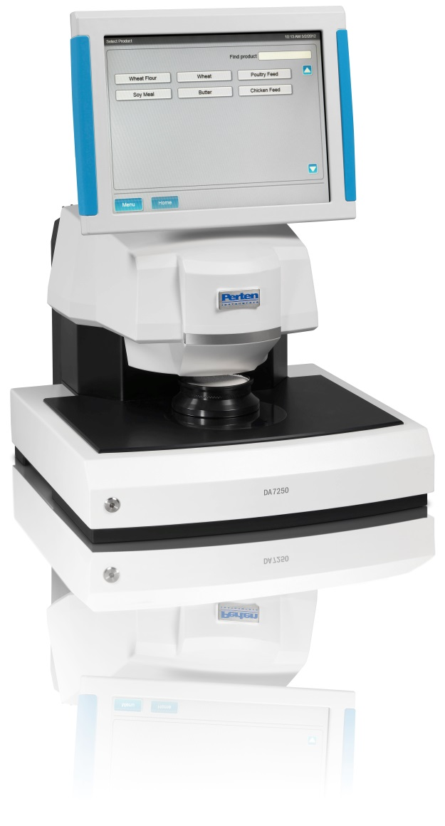
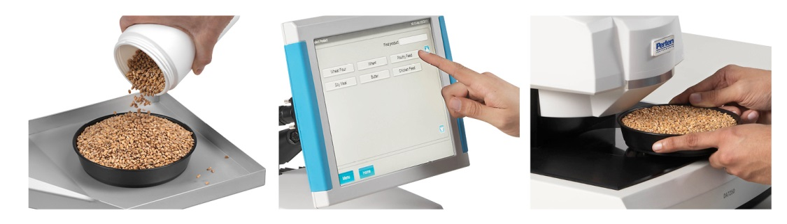
DA 7250 NIR Analyzer
6-second analysis
Grains, slurries, powders and more
No sample preparation
Highly accurate

Slide 20
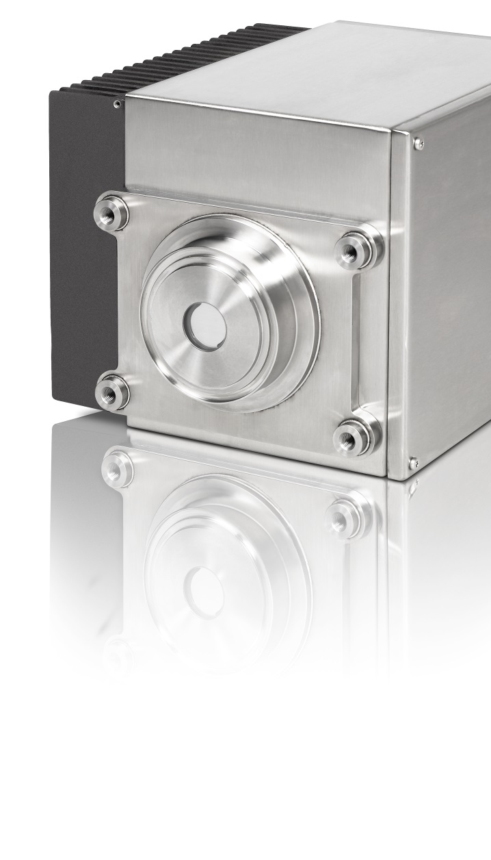
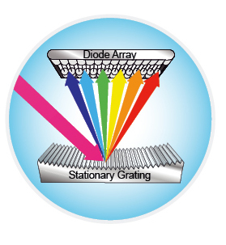
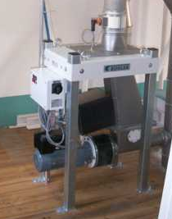
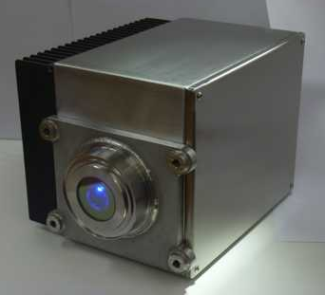
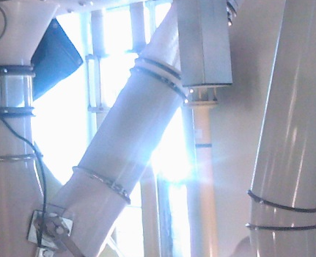
NIR – Applications in Process Industries
Until now majority of on line analyzers are filter based. Our new offer includes on line measurement using diode array technology.

Slide 21
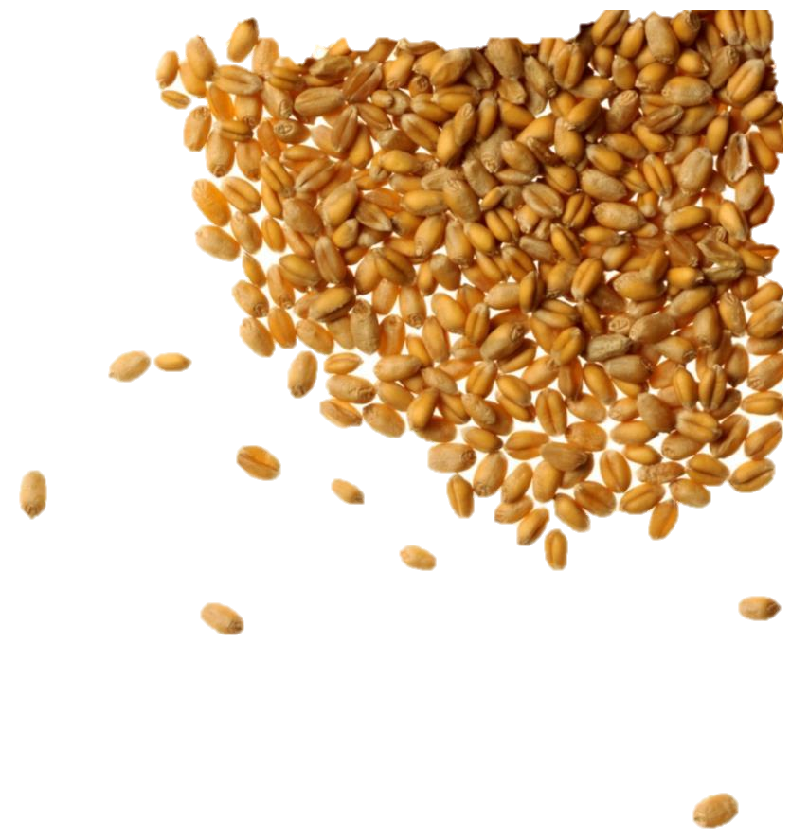

Inframatic 9500
Grain
Sorting grain according to quality
Moisture, protein, wet gluten, Zeleny, optional hectolitre weight / test weight
Payment analysis
Flour – with optional flour module
Quality control during milling & finished flour specification
Moisture, protein, ash, wet gluten, Zeleny, flour whiteness L*

Slide 22
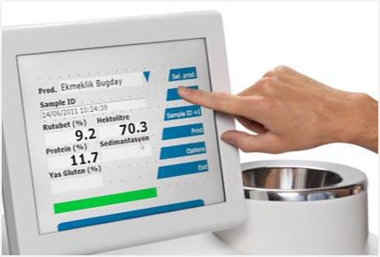
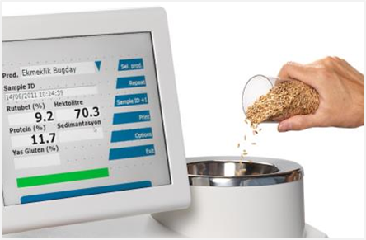
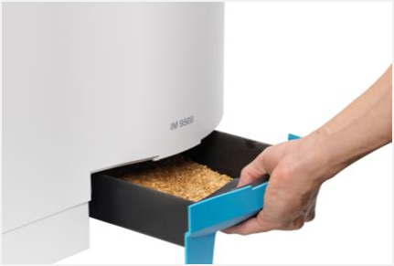
Grain Analysis – Designed for Users
Grain
Operate from 12” Large Colour Touch Screen
Rapid & simple!
User interface in many local languages
1. Select
2. Pour
3. Remove

Slide 23
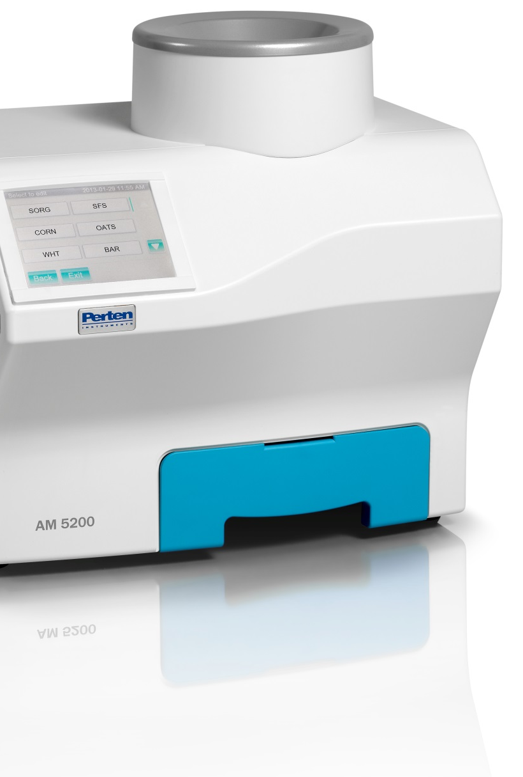
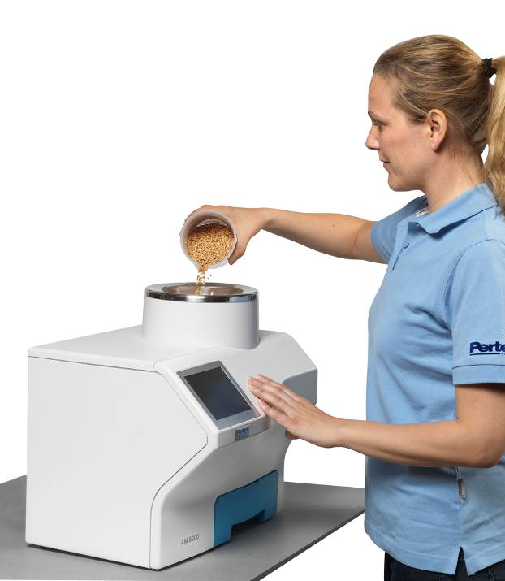
Next Generation Moisture Meter
New technology
Based on USDA research
Superior accuracy
All grains and oilseeds
Moisture, specific weight and temperature
No calibration updates
One calibration for all products

Slide 24
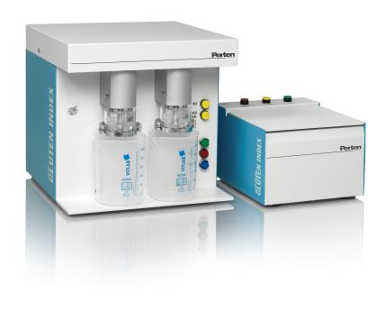
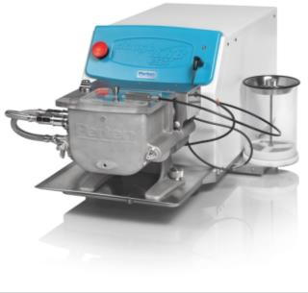
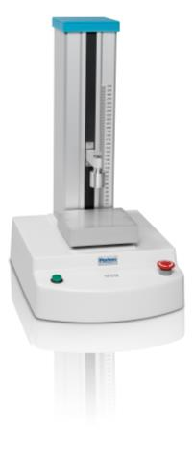
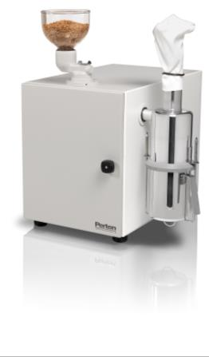
Functional analysis

Slide 25
Functional analysis

Slide 26
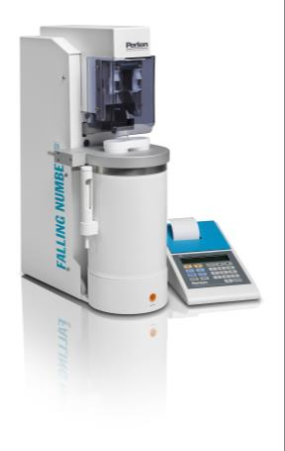
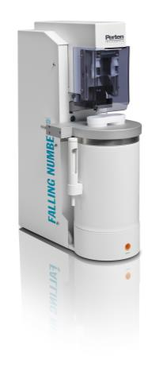
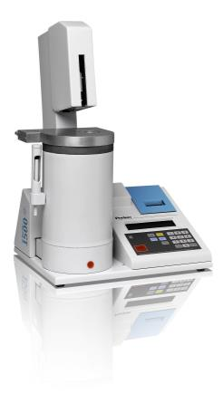


The Falling Number System
Falling Number 1900 Automatic model for double determinations.
Falling Number 1700 Automatic model for double determinations.
Falling Number 1500 standard or Fungal Automatic single determination model Fungal - determination of total alpha-amylase activity in flours supplemented with fungal enzymes.
Falling Number 1310 Automatic single determination model.
Notes:
Why?
Segregation/classification of wheat and rye. - To detect possible sprout damage. - To meet different end-product requirement, - To meet trade contract specifications.
Optimise flour alpha-amylase activity for bread baking and other flour end uses.
Guarantee soundness of traded grain.
Who:
Breeding for sprout resistant varieties.
Big Farmers or Cooperatives. Control of optimum harvest time.
Grain Intake. Segregation/Classification of grain for different end use. Price setting to farmer.
Flour Mill. - Monitoring of incoming raw material and of the produced flours. - Control in blending of grain and flours to achieve consistent flour qualities. - Calculation and control of barley malt addition and fungal enzyme addition to obtain optimum enzyme activity.
Major Bakeries. - Monitoring of incoming flours. - Control in blending of flours.
International Trade. - Major exporters offer a minimum Falling Number guarantee on trade contracts. - The European Common Market minimum Falling Number for intervention bread wheat is 220 - a lower value causes price reduction.

Slide 27


The Glutomatic System
Glutomatic 2200 & Centrifuge 2015 For Wet Gluten Content and Gluten Index.
Glutork 2020
For Dry Gluten Content.
Notes:
Why measure gluten?
Segregation of wheat deliveries at silo intake on the basis of dough strength, dough stability and dough handling properties.
At the same protein content, gluten may vary widely.
At the same gluten content, characteristics may vary widely.
Different end-products require different wheat qualities.
Industrial use require consistent quality.
The quality affects the economical value of the wheat.

Slide 28



Instrument Solutions - RVA
Rapid Visco Analyser
Rapid heating & cooling rotational viscometer
Viscosity measurement (canister & paddle)
Temperature control/Shear control
RVA 4500 high sensitivity down to 10 cP & up to 50,000 cP, TCW software
RVA-TecMaster mid range (TCW3 & stand alone)
RVA-StarchMaster2 (stand alone)

Slide 29


doughLAB models
doughLAB: 300g or 50g Z-arm mixing to determine flour processing quality.
micro-doughLAB: 4g (research/breeder scale) uses the same methodology and correlates with large scale methods.
Notes:
Traditional dough mixers such as Brabender Farinograph and doughLAB measure dough viscosity. They are mostly used to determine flour processing quality (water absorption and dough mixing paramters).
Most common measurements are Water Absorption (WA) and Dough Development Time (DDT).
90% of installed base worldwide uses 300g size bowl.
Large sample requirements (50g or 300g flour) make the traditional methods cumbersome and poorly suited for use by wheat breeders and researchers. The small sample requirement (4g flour) of micro-doughLAB makes it well suited for use by wheat breeders and researchers who typically have limited sample available to them for testing. It can be used to screen breeder lines with desirable quality traits at the F4 and possibly the F3 stage. It is ideal when the amount of sample, technician time and instrument time are limited. It can also be used to develop rapid and small scale methods that correlate to standard methods.

Slide 30

Global presence
With distributors we cover 100 countries around the world.

Slide 31
Customer focus
Short lead time and shipments on time
Extensive after sales support and service
Predictive Maintenance Packages
Reference samples for verifying instrument accuracy
NIR Calibration support and service
Global service organization in all time zones
Customized Engineering and Software adoptions
On-line sample presentation
Software integration

Slide 32

Perten Instruments Group Sales
CAGR
15-20 %

Slide 33

Questions

Slide 34


Slide 35

Your partner in Agri Food Quality Control

